Slide 1
An Analysis of the World Suicide Data
Project Team #7
Mujgan Guner, Ahmed Lotfy, Shanker Nair
June 25, 2020

Slide 2
Outline

Slide 3
Dataset Overview
Suicide is a public health problem and one of the leading cause of death globally.
Organizations such as WHO, NIMH and many countries’ public health organizations collect and analyze data related to suicide.
For this study, “Suicide rates overview 1985 to 2016” from Kaggle is used.
The dataset was in “csv” format.

Slide 4
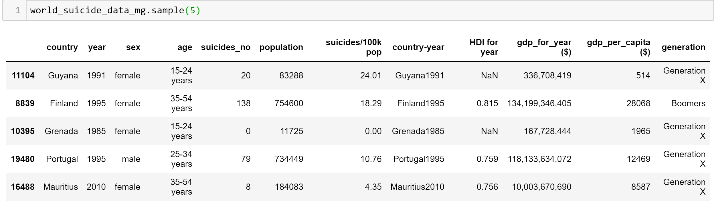
Dataset Overview ...
There are 12 columns and 27820 rows in the dataset.
Continents and Latitudes columns are added later for further analysis
Columns with mostly “Null” values are removed

Slide 5
Dataset Overview …
The dataset covers the years from 1985 to 2016.
However, reporting is not very consistent per year and per countries
Therefore, data slicing was applied considering different year periods to stay consistent with the countries and years.
Slices considered as:
Time span of 2000 to 2014 (58 countries)
Year 2009 data – the most countries data is available (86 countries)

Slide 6
Questions we seek to answer
What is the global trend in the suicide rate over the years?
Are men or women more likely to commit suicide?
How does suicide and the wealth of a country correlate?
Which age group is more susceptible to suicide?
How does the economies affect the suicide rate?
Is there any …

Slide 7
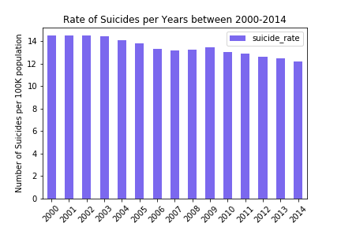
Global Suicide Rate Over the Years
There is a slight decline on suicide rate over 15 years time span globally

Slide 8
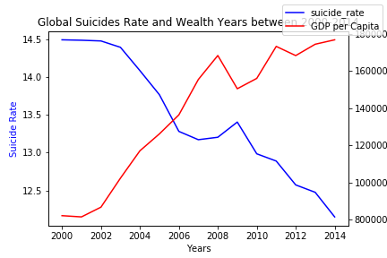
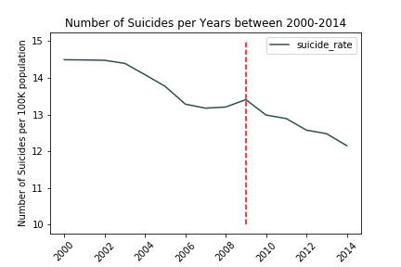
Global Suicide Rate over the Years
In fact overall GDP/capita in the world increased over the year, while the suicide rate was decreasing.
There is a slight increase in the suicide rate in 2009, while the GDP/capita shows a decrease.
Can it be attributed to the global economic crisis during 2008 and 2009 (?)

Slide 9
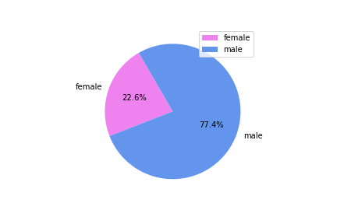
Suicide Rate and Gender
Data indicates that men are about 3.4 times more susceptible to suicide than women

Slide 10
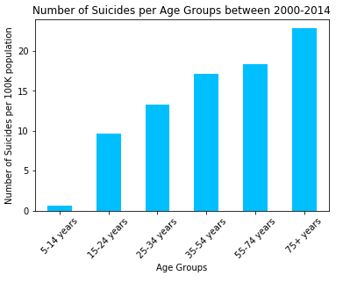
Suicide Rate and Age Group
Elderly people are more likely to commit suicide.

Slide 11
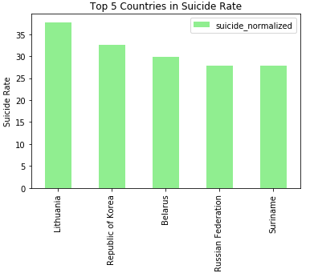
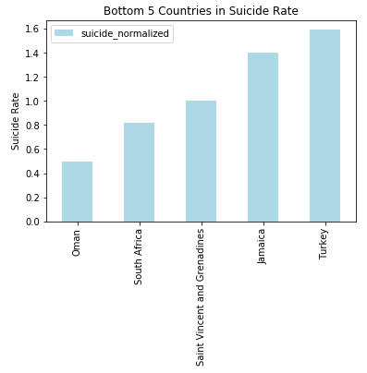
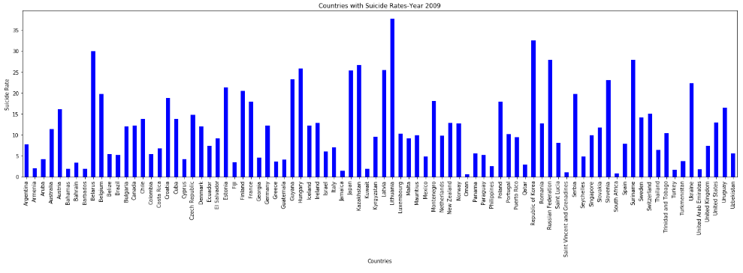
Top 5 and Bottom 5 Countries by Suicide Rate
For each year, this list needs an updates, because the countries suicide rates changes per year

Slide 12
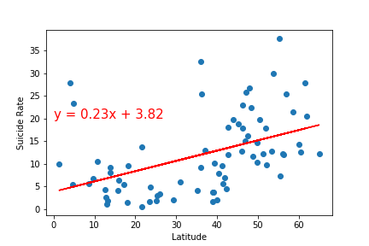
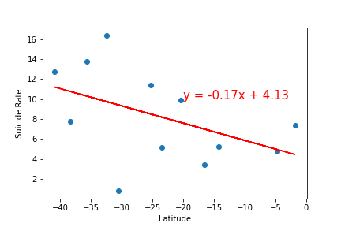
Suicide Rate and Latitude
Northern Hemisphere
Weak correlation between northern and southern hemispheres
In general suicide rate is increasing with the higher latitudes (higher in absolute value, getting further away from equatorial line)
Southern Hemisphere

Slide 13
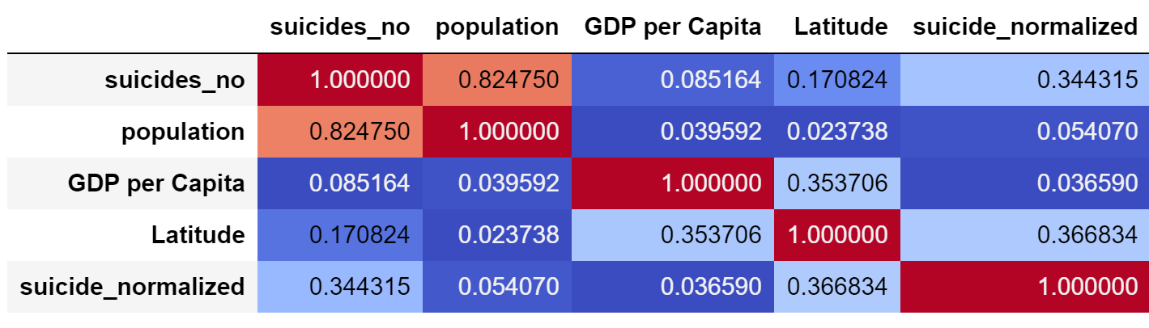
2009 data Correlation Matrix

